Slide 1
Setting Up Rstudio & the Simple Biostats Program
Department of Biostatistics
St. Jude Children’s Research Hospital

Slide 2

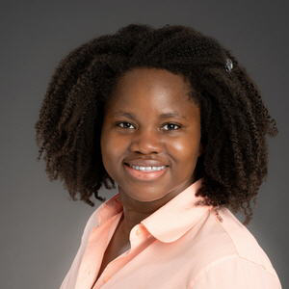



Biostatistics Orientation Team
Lakshmi
Patibandla
Dora Obodo
Abdel Elsayed
William Wu
Saikat Nandy

Slide 3

Stan Pounds
St. Jude Graduate School
Biostat I Course Leader since 2017
Associate Dean of MS in Applied Biomedical Data Sciences
St. Jude Research Hospital
Biostatistics Faculty since 2002
Statistical Leader of AML Program
Statistical Cancer Multi-Omics

Slide 4
GCH Biostatistics Instructor(s)
To Be Determined …

Slide 5
Set Up Steps
IS leads the R+Rstudio installation from Company Portal
Biostats leads installation of Rtools (4.5) from CRAN
Biostats leads set up of R studio desktop icon & taskbar button
Biostat leads removal of base R desktop icon (to minimize confusion)

Slide 6
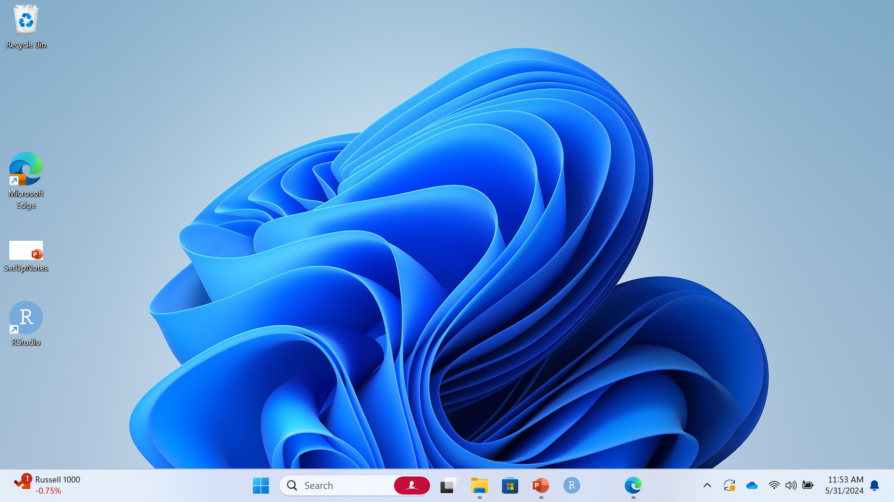
Install R Tools 4.5
Double click Microsoft Edge

Slide 7
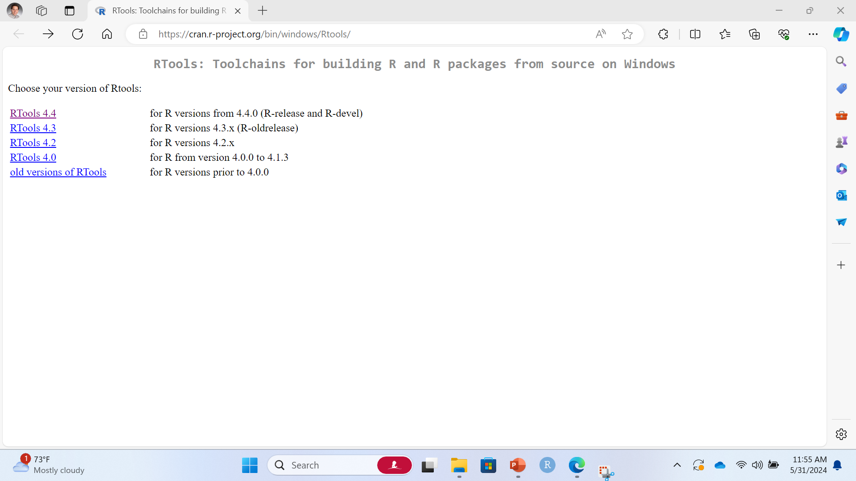
Install R Tools 4.5
https://cran.r-project.org/bin/windows/Rtools/

Slide 8
Install R Tools 4.5
Click on “RTools 4.5”

Slide 9
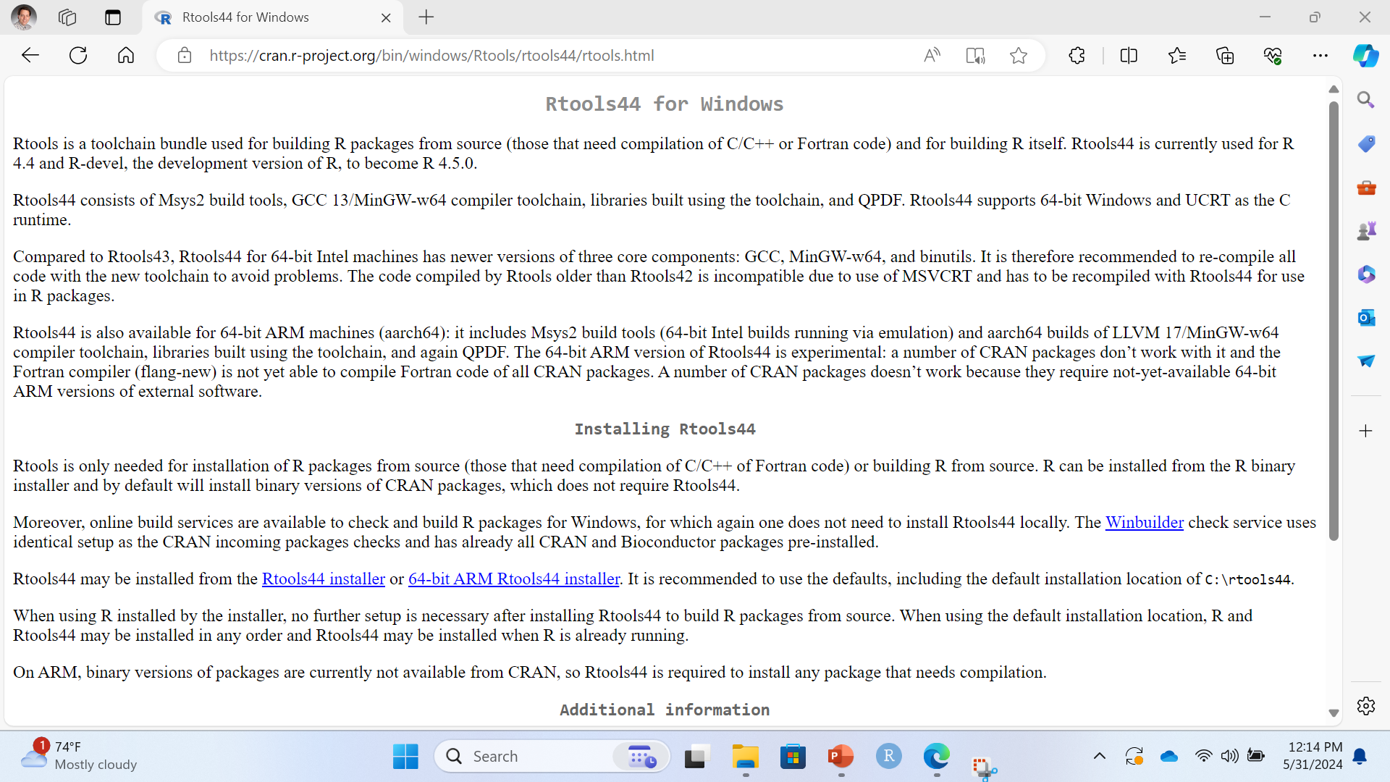
Install R Tools 4.5
Click on “Rtools45 installer”

Slide 10
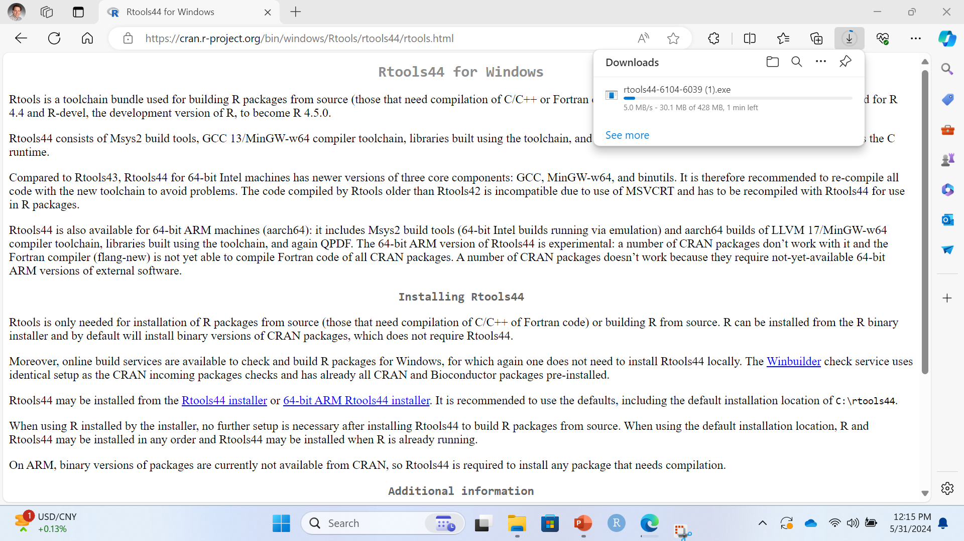
Install RTools 4.5
Download begins

Slide 11
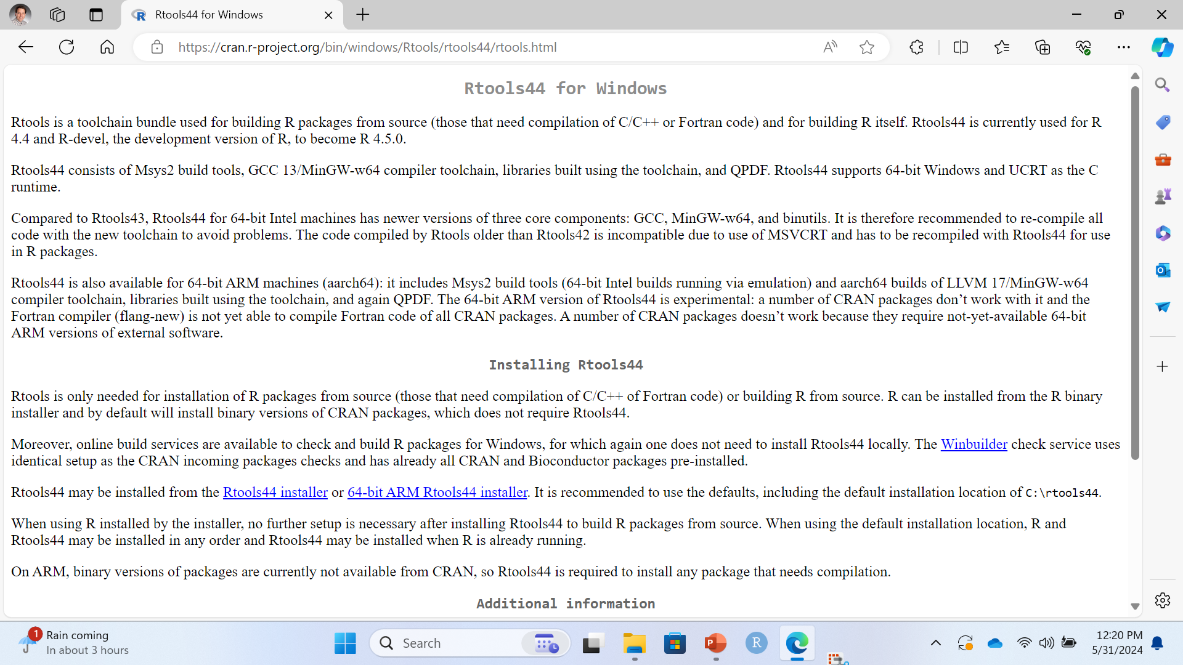
Install R Tools 4.5
Click “…” then “Downloads”

Slide 12
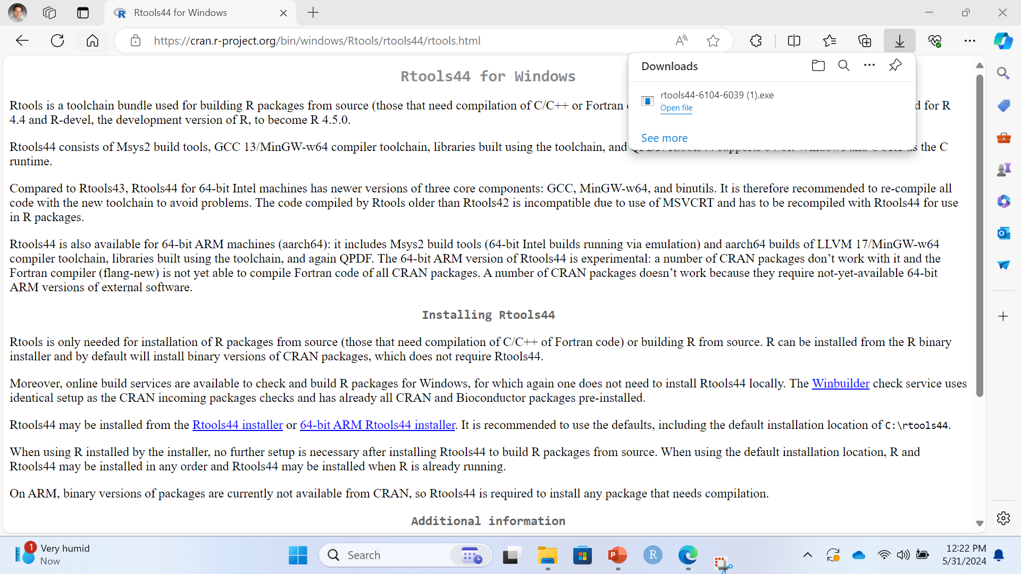
Install R Tools 4.5
In the Downloads window, Click “Open File”

Slide 13
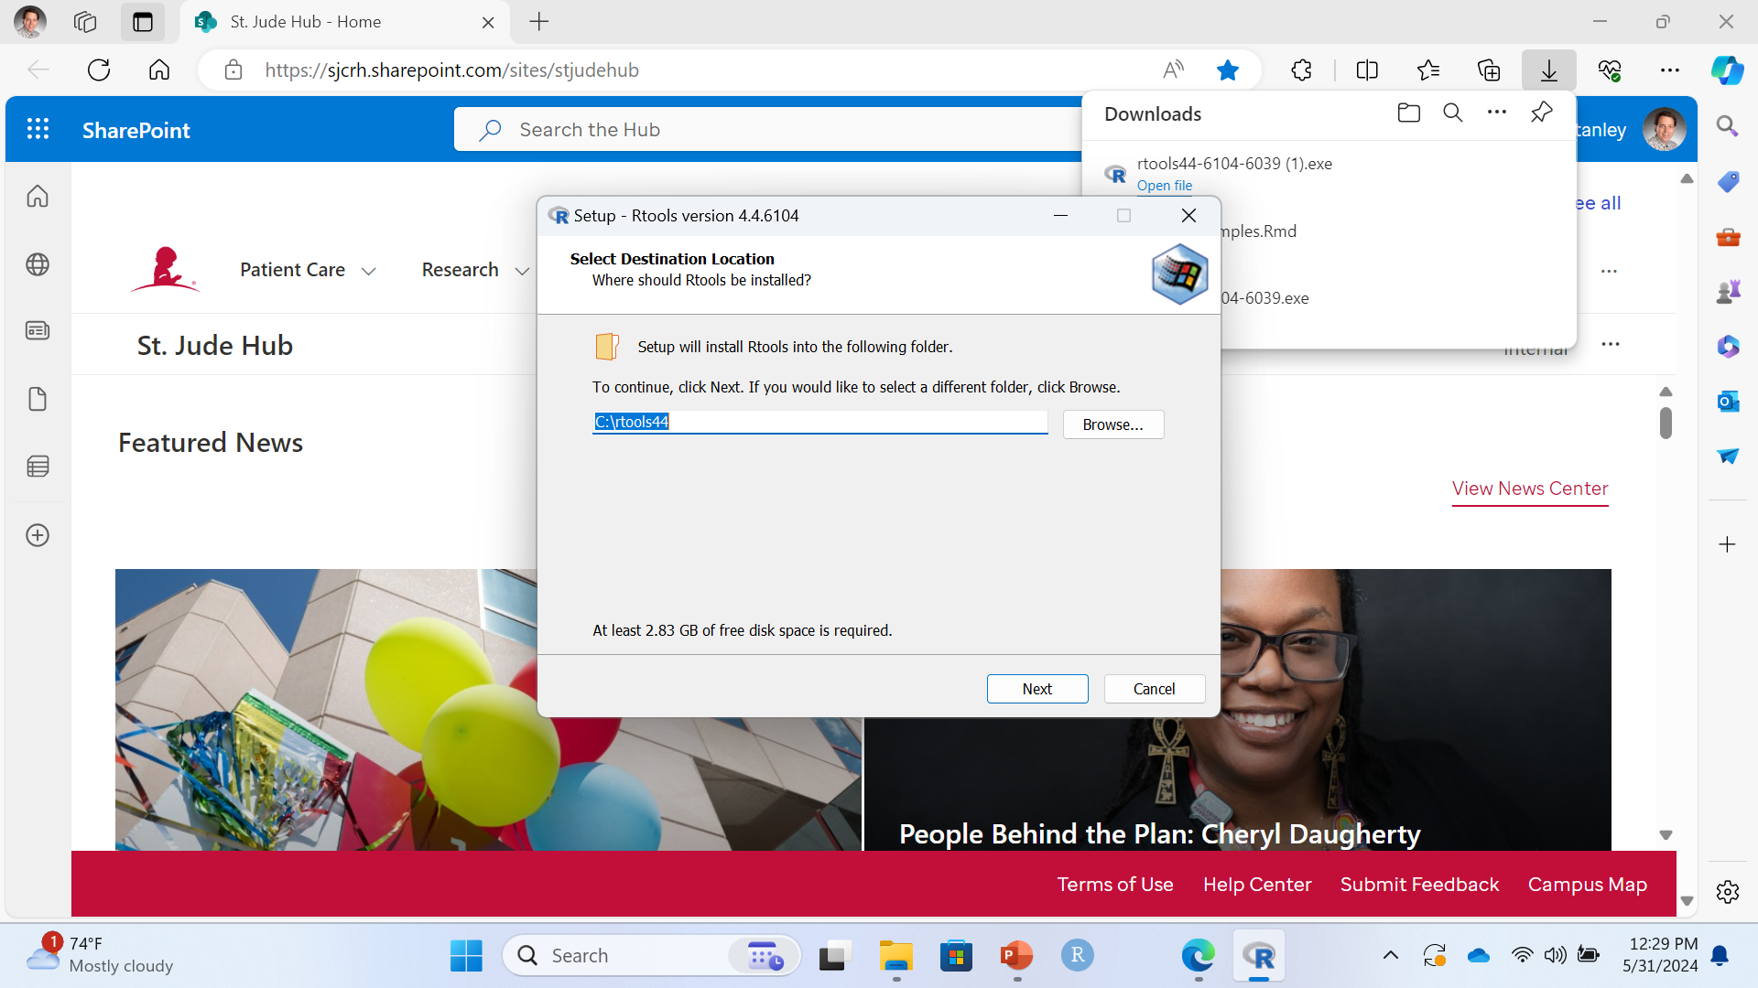
Install R Tools 4.4
Do you want to let Rtools installer make changes? YES
Click Next … Next … Install.

Slide 14
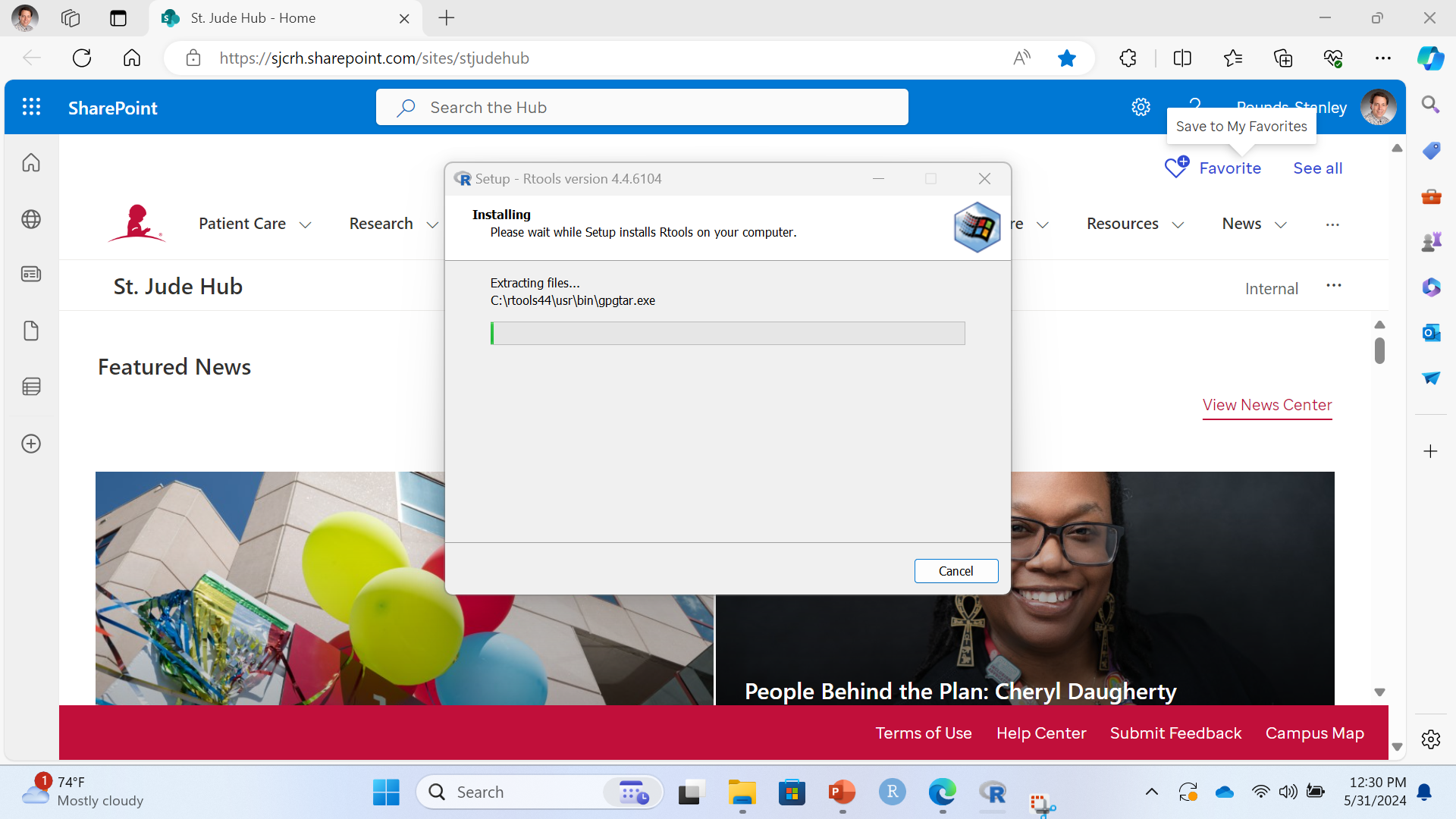
Install R Tools 4.4
Installing ….

Slide 15
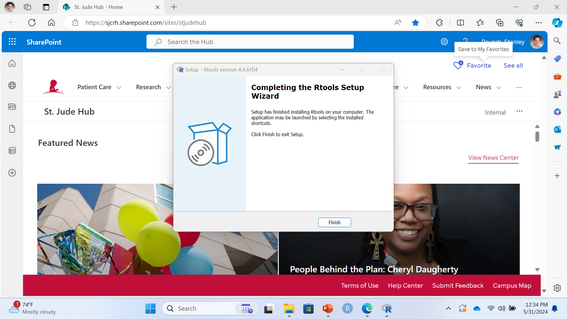
Install R Tools 4.5
DONE!
Click Finish!

Slide 16

Double Check R Tools Installation
Click Windows Explorer

Slide 17
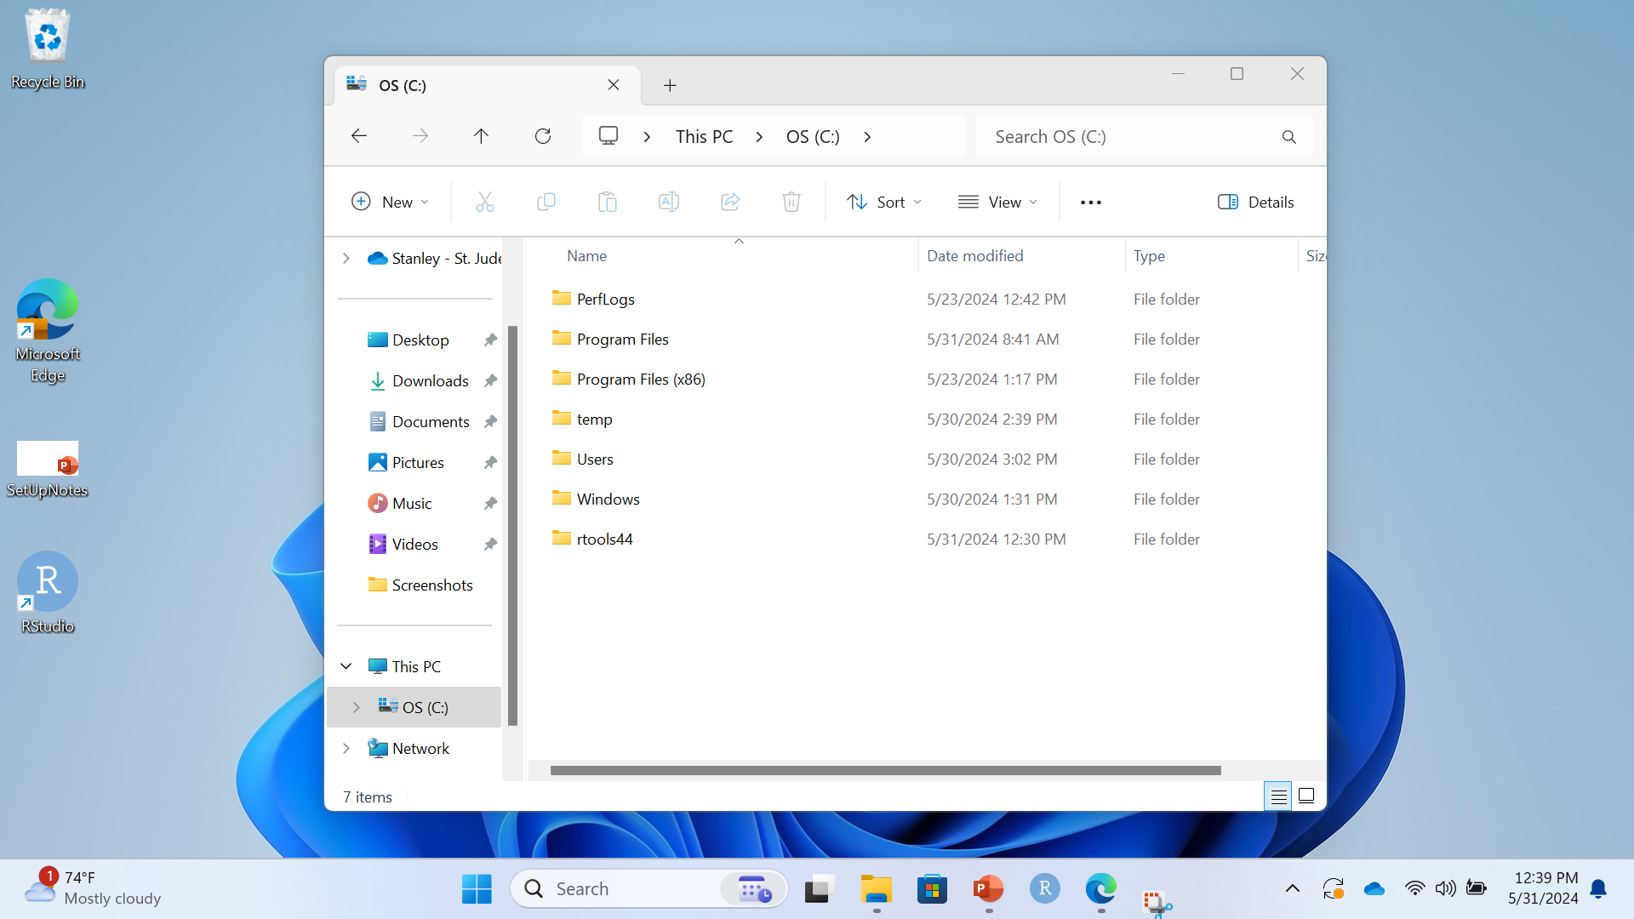
Double Check R Tools Installation
Click on C: Drive

Slide 18
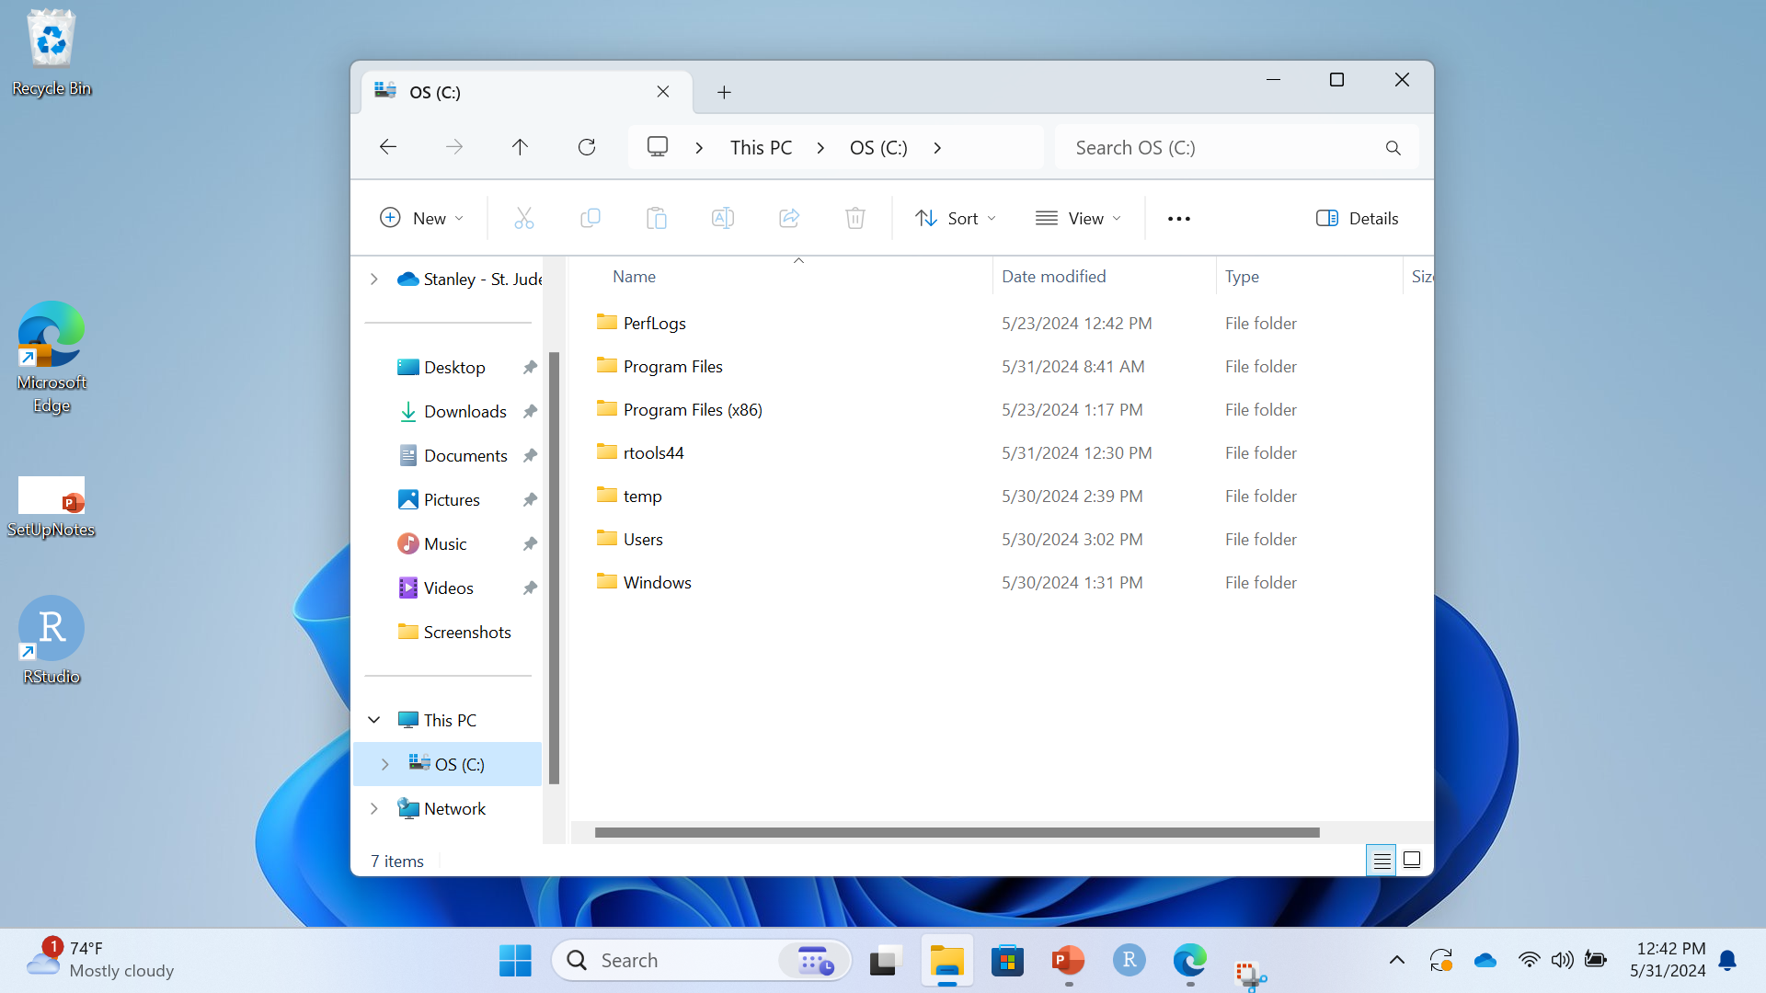
Double Check R Tools Installation
Find the rtools44 folder
CONGRATS!!!!
You now have Rtools!

Slide 19

Add Rstudio to taskbar
Type “R Studio” in the Search Box

Slide 20
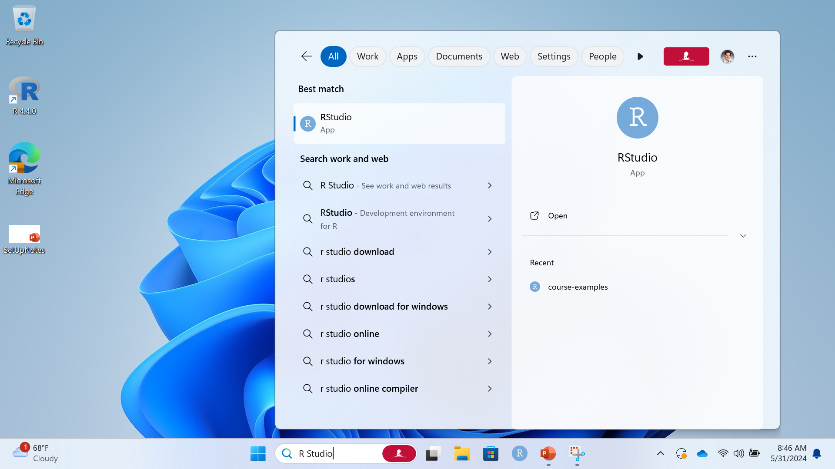
Add R Studio to Task Bar
Right click and choose “pin to task bar”

Slide 21
Add R Studio to taskbar
Right click and choose “open file location”

Slide 22
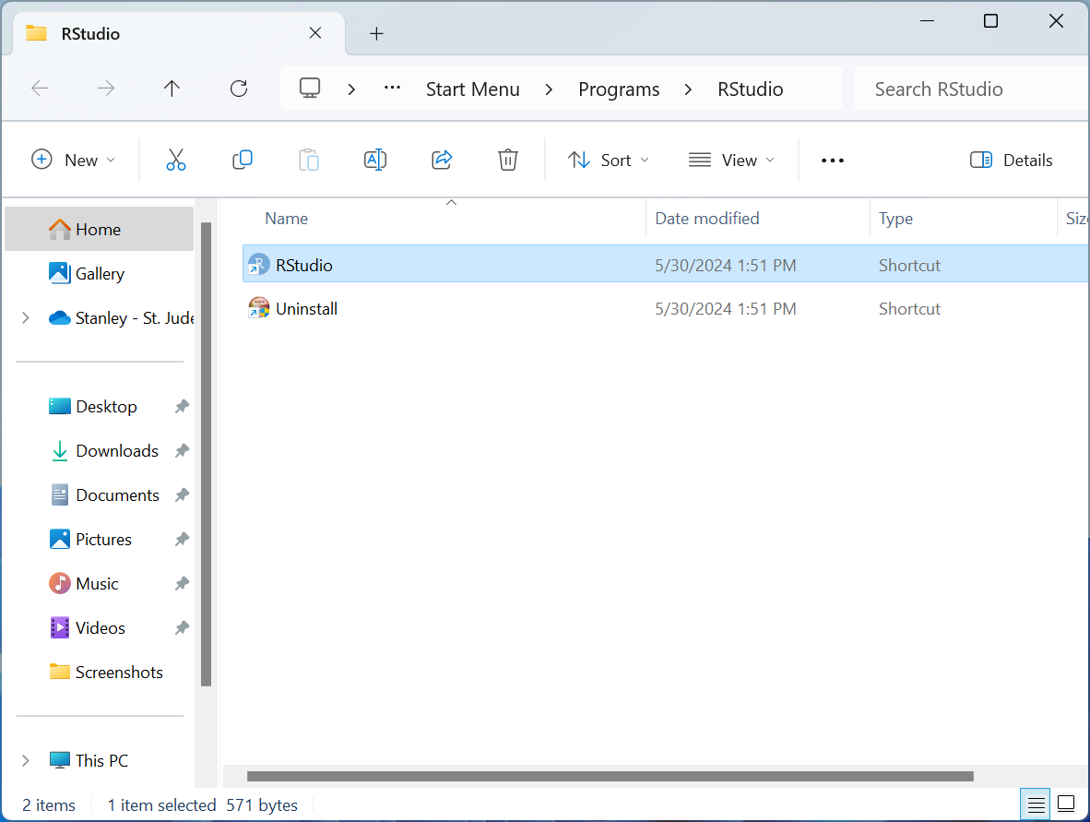
Add R Studio icon to the desktop
Right-click … Show More Options … Create Shortcut
Click “Yes” to create on the desktop instead.

Slide 23

Remove R icon from the Desktop
Right click … Trash Can Icon (Delete)

Slide 24

When You’re Done
R Studio icon on desktop
R Studio icon on task bar

Slide 25
Simple Biostat Program
A Simplified Interface for R
Covers Introductory Biostatistics in ~15 commands instead of ~100
Simplified Options (~6 options instead of ~200)
Generates Figures, Tables, and Draft Narratives for Each Procedure
Successfully Incorporated into Instruction
Minimize technical frustrations and distractions
Students focus on statistical & scientific reasoning

Slide 26
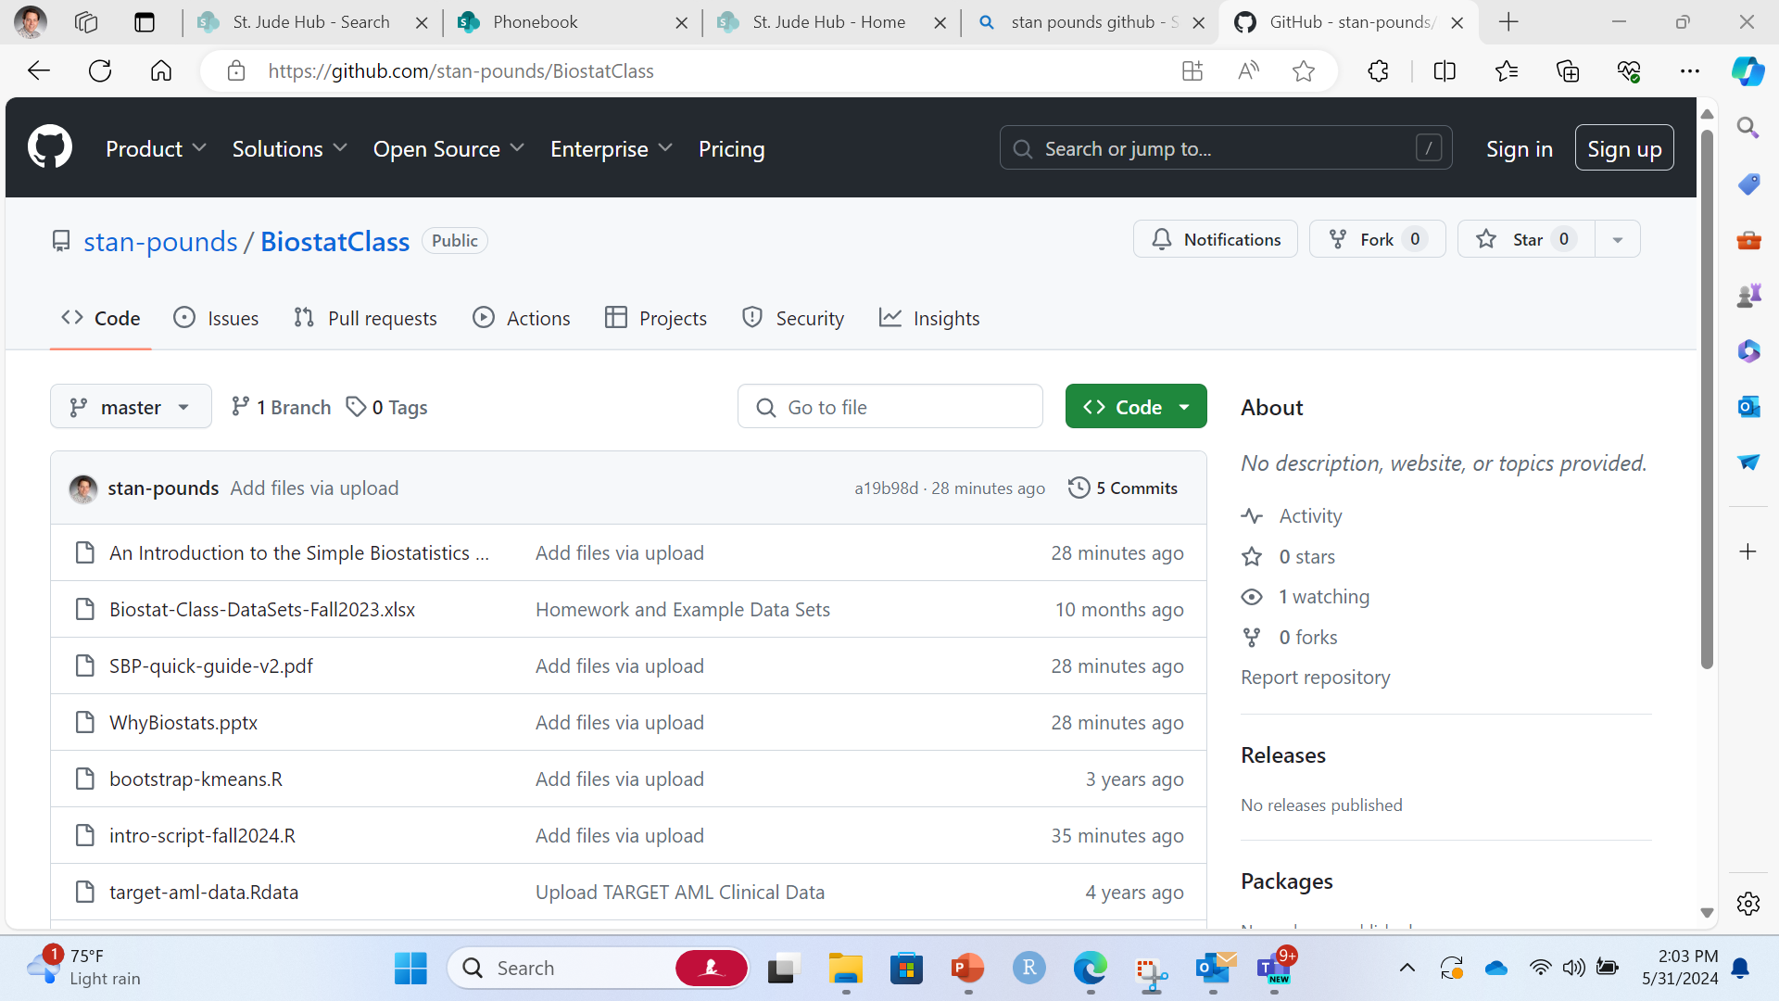
Simple Biostat Program (SBP)
https://github.com/stan-pounds/BiostatClass
SBP-quick-guide-v2.pdf

Slide 27
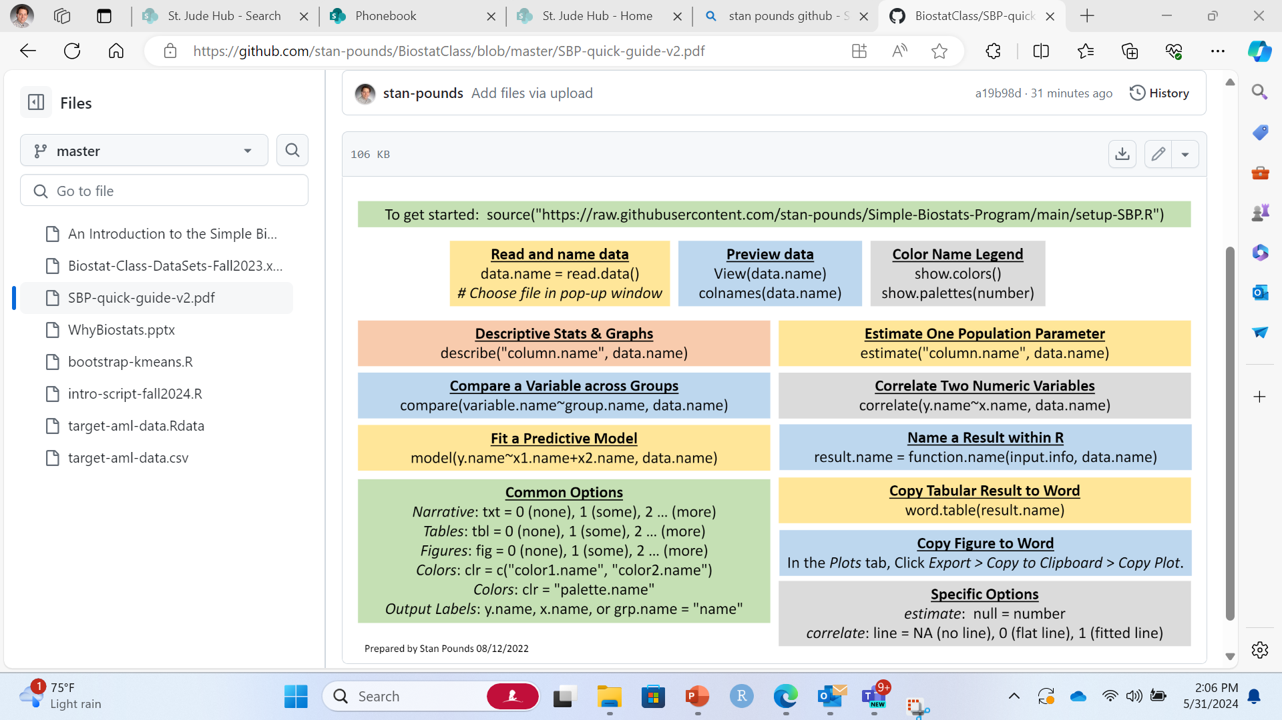
Simple Biostat Program (SBP)
Click Download Icon.

Slide 28
Simple Biostat Program (SBP)
Click Download Icon.

Slide 29
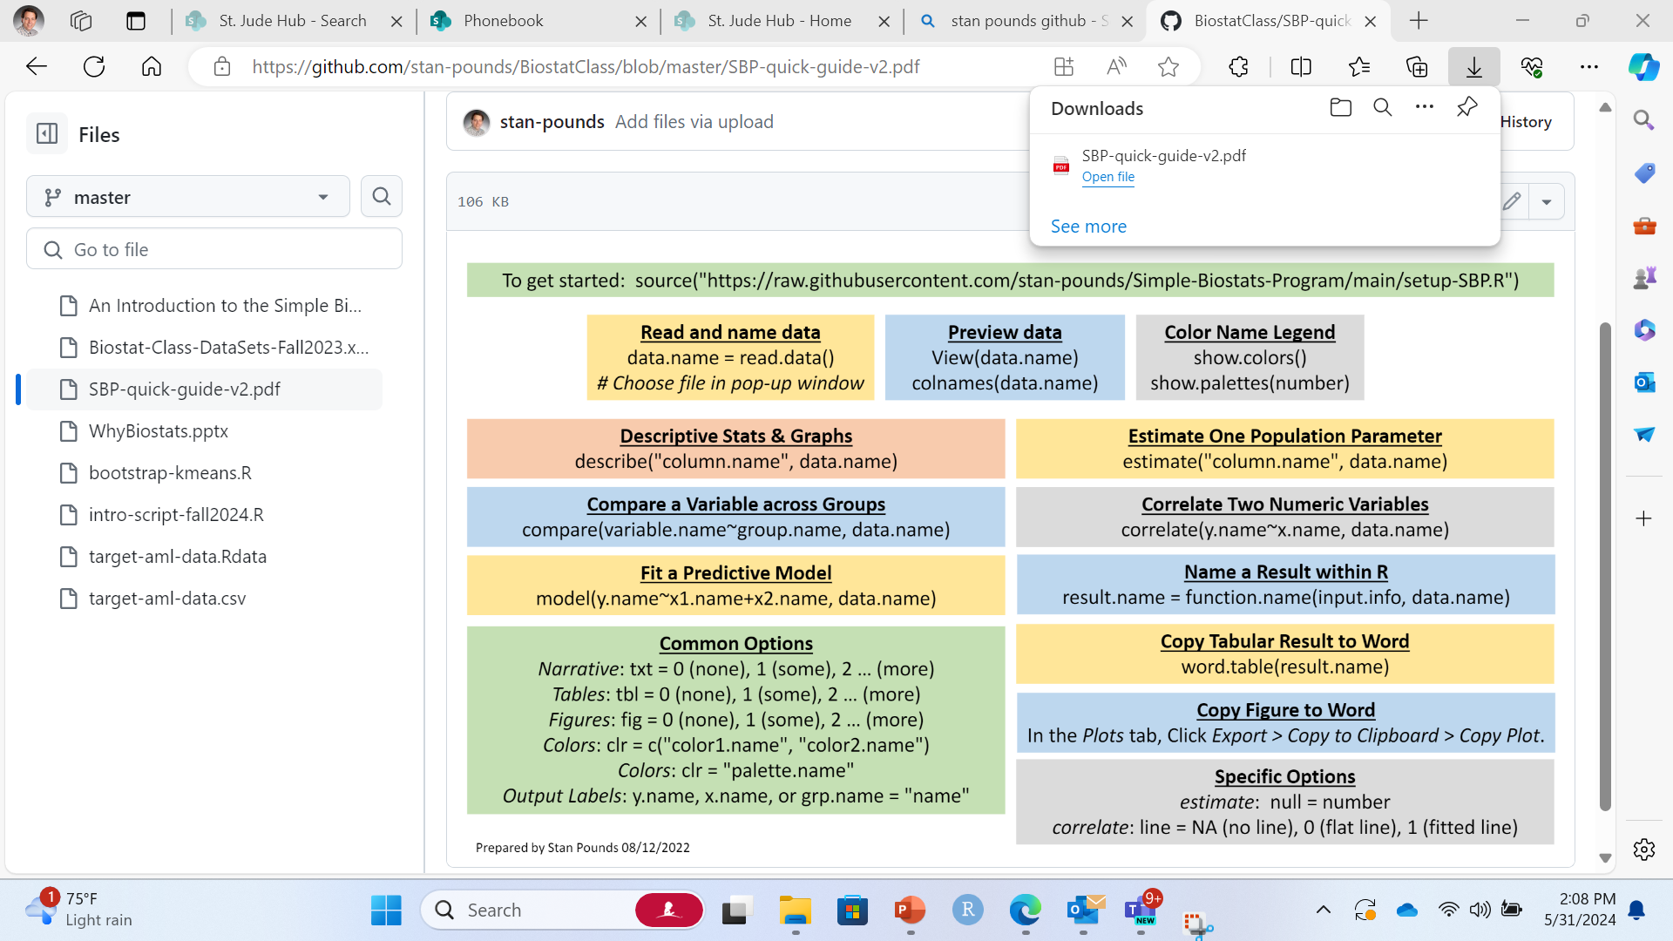
Simple Biostat Program
Click “Open file”.

Slide 30
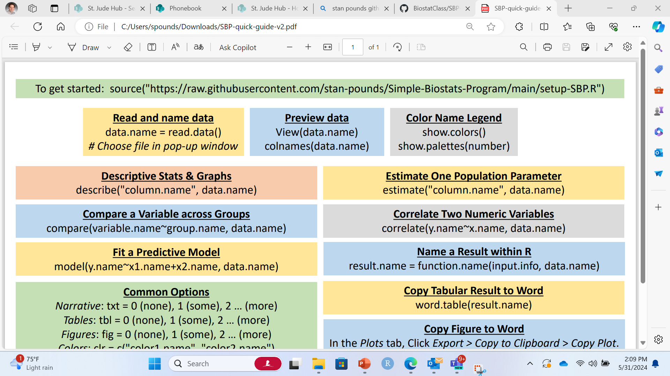
SBP

Slide 31

Open R Studio
Click the R Studio icon on the task bar at the bottom.

Slide 32
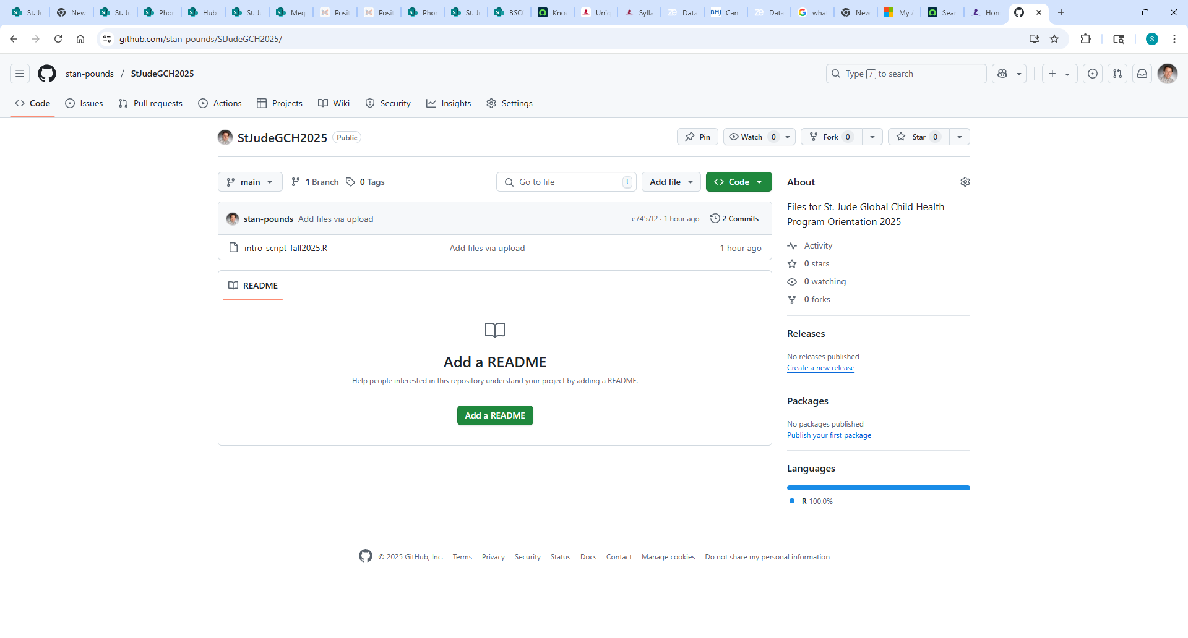
https://github.com/stan-pounds/StJudeGCH2025
intro-script-fall2025.R

